Slide 1
Talk Tech
Nuri Hannan
Lukas Sagmani
Lilyan Toma

Slide 2

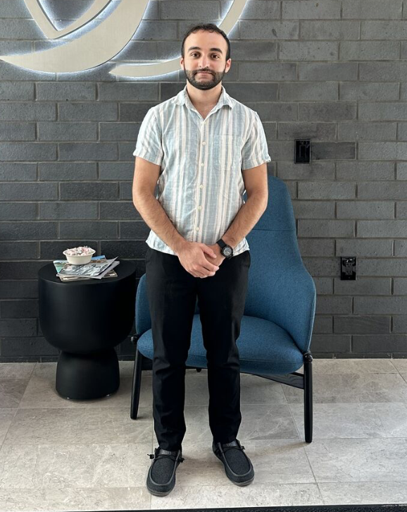
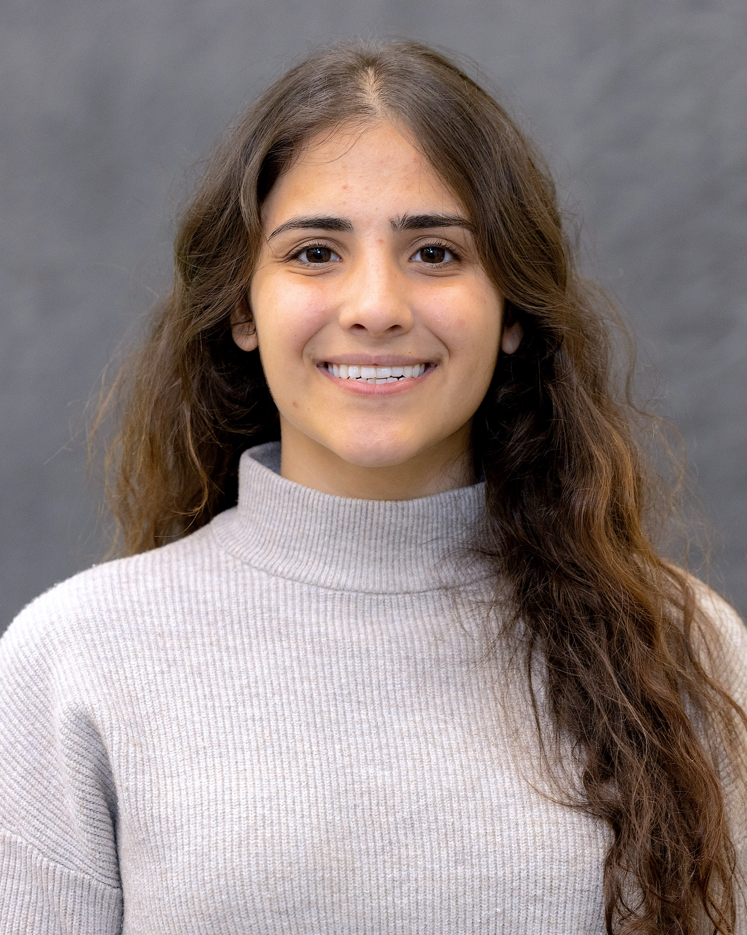
Meet The Team
FamilyID=Office_ArchiveTorn

Slide 3
Contents
Idea
What
How
Why
Demo

Slide 4
Idea
Better Version Of LinkedIn

Slide 5
What
Website and app for early-career individuals and students
Helps find local and broader opportunities
Promotes small businesses and community-based opportunities
Features places like TechTown in Detroit
Includes nearby volunteering opportunities for networking

Slide 6
How
Connects users with local opportunities and businesses needing help
Creates a network focused on community support and growth
Serves as a community-oriented alternative to LinkedIn
Emphasizes local opportunities over personal self-promotion

Slide 7
Why
Goal: Build and strengthen communities by advertising local opportunities
Focuses on community growth and support
Aims to uplift individuals and businesses
Fosters a collaborative environment for career development
Promotes local economic growth

Slide 8
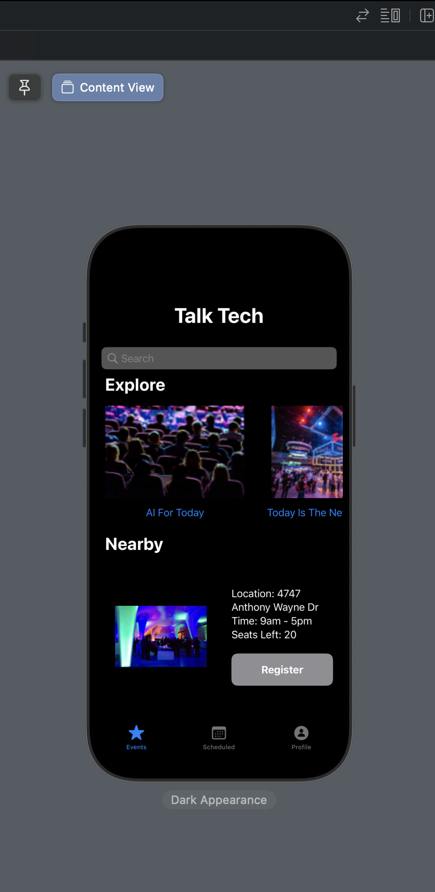
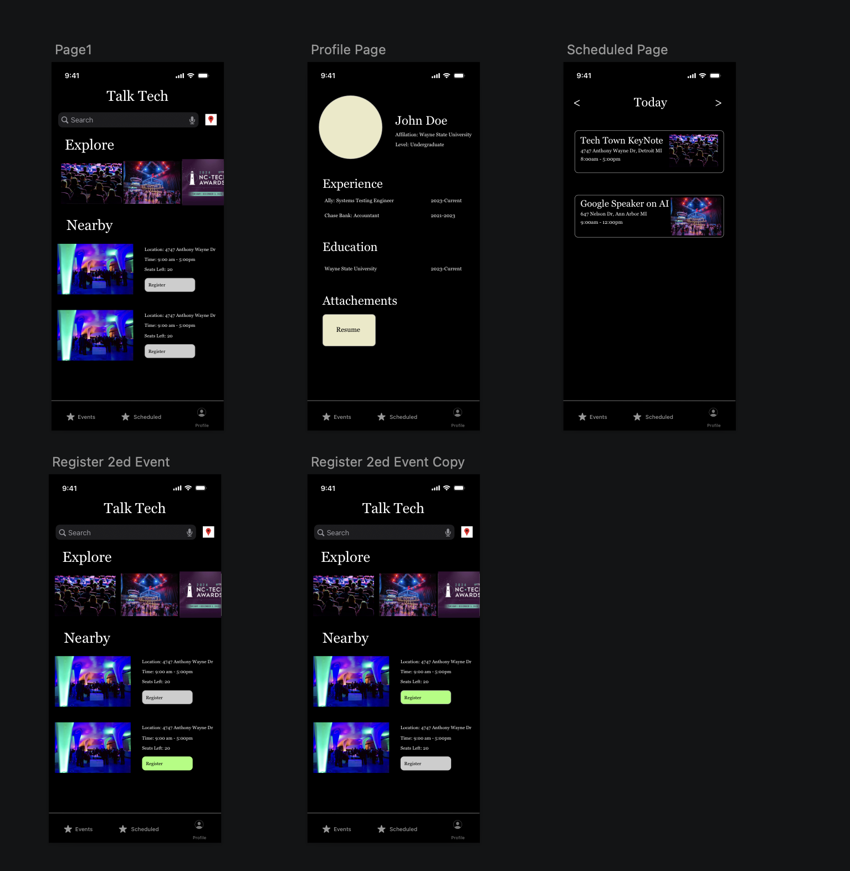
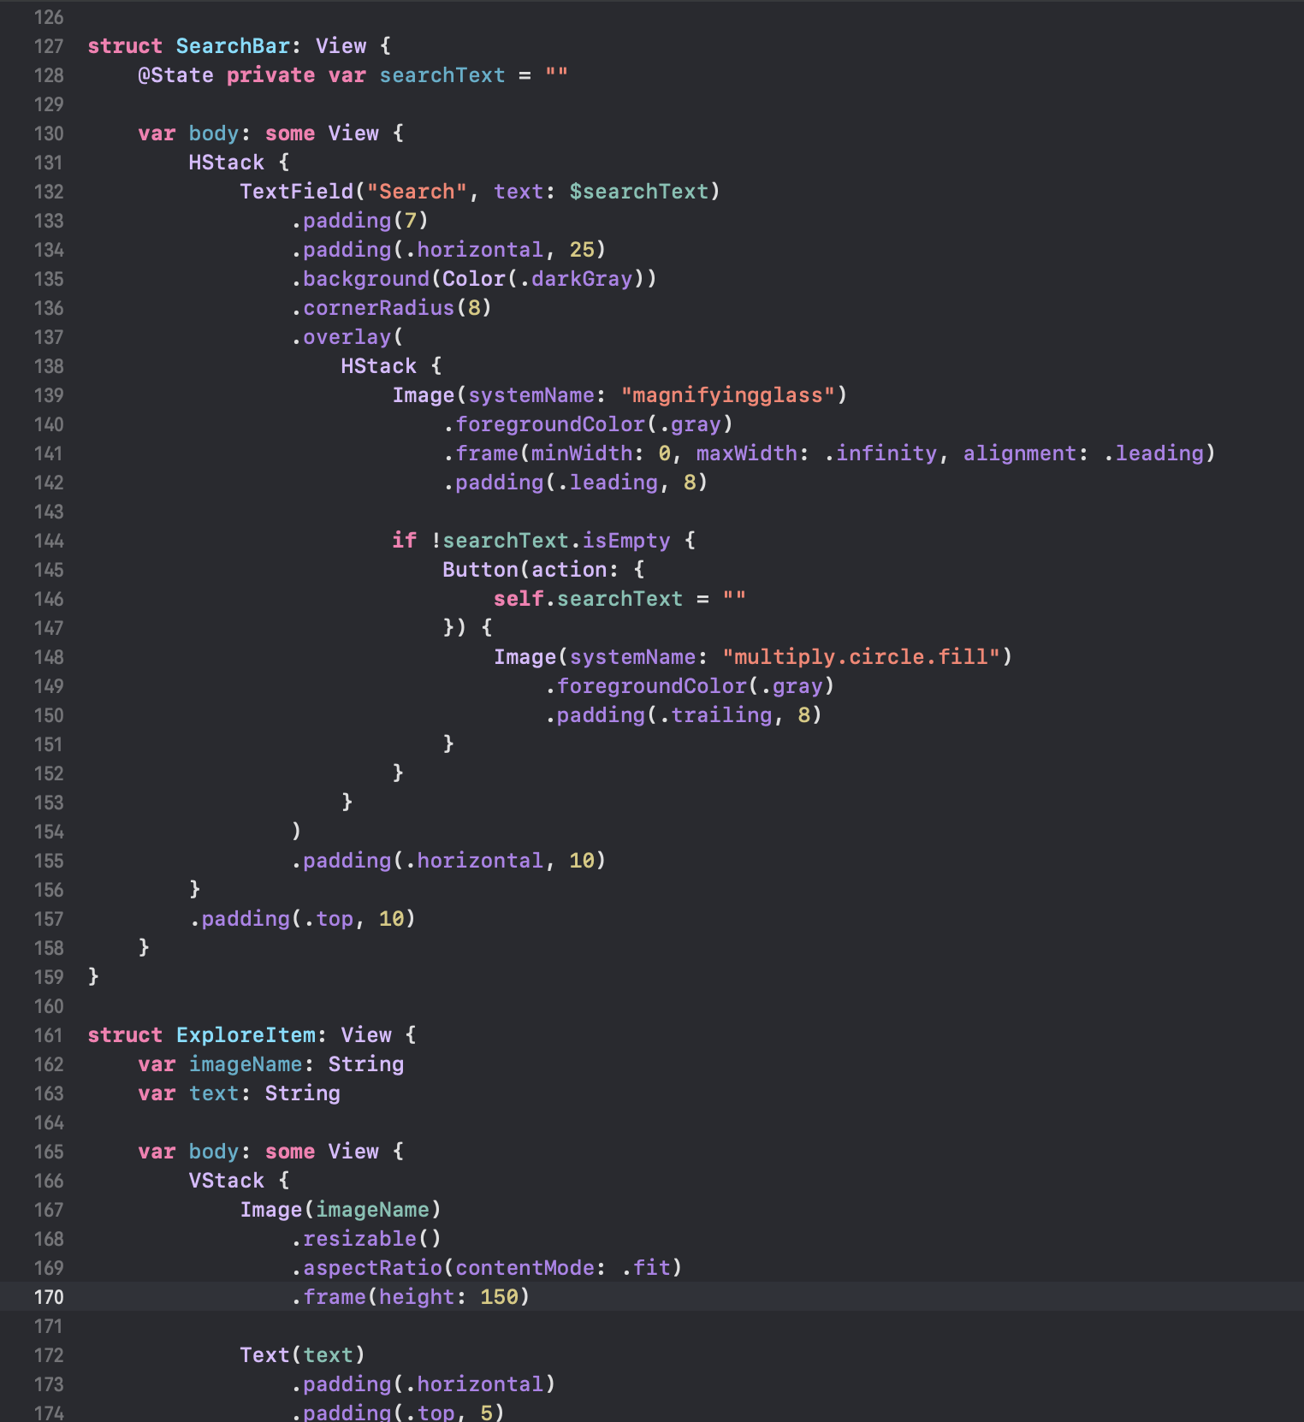
Application - The Backend

Slide 9
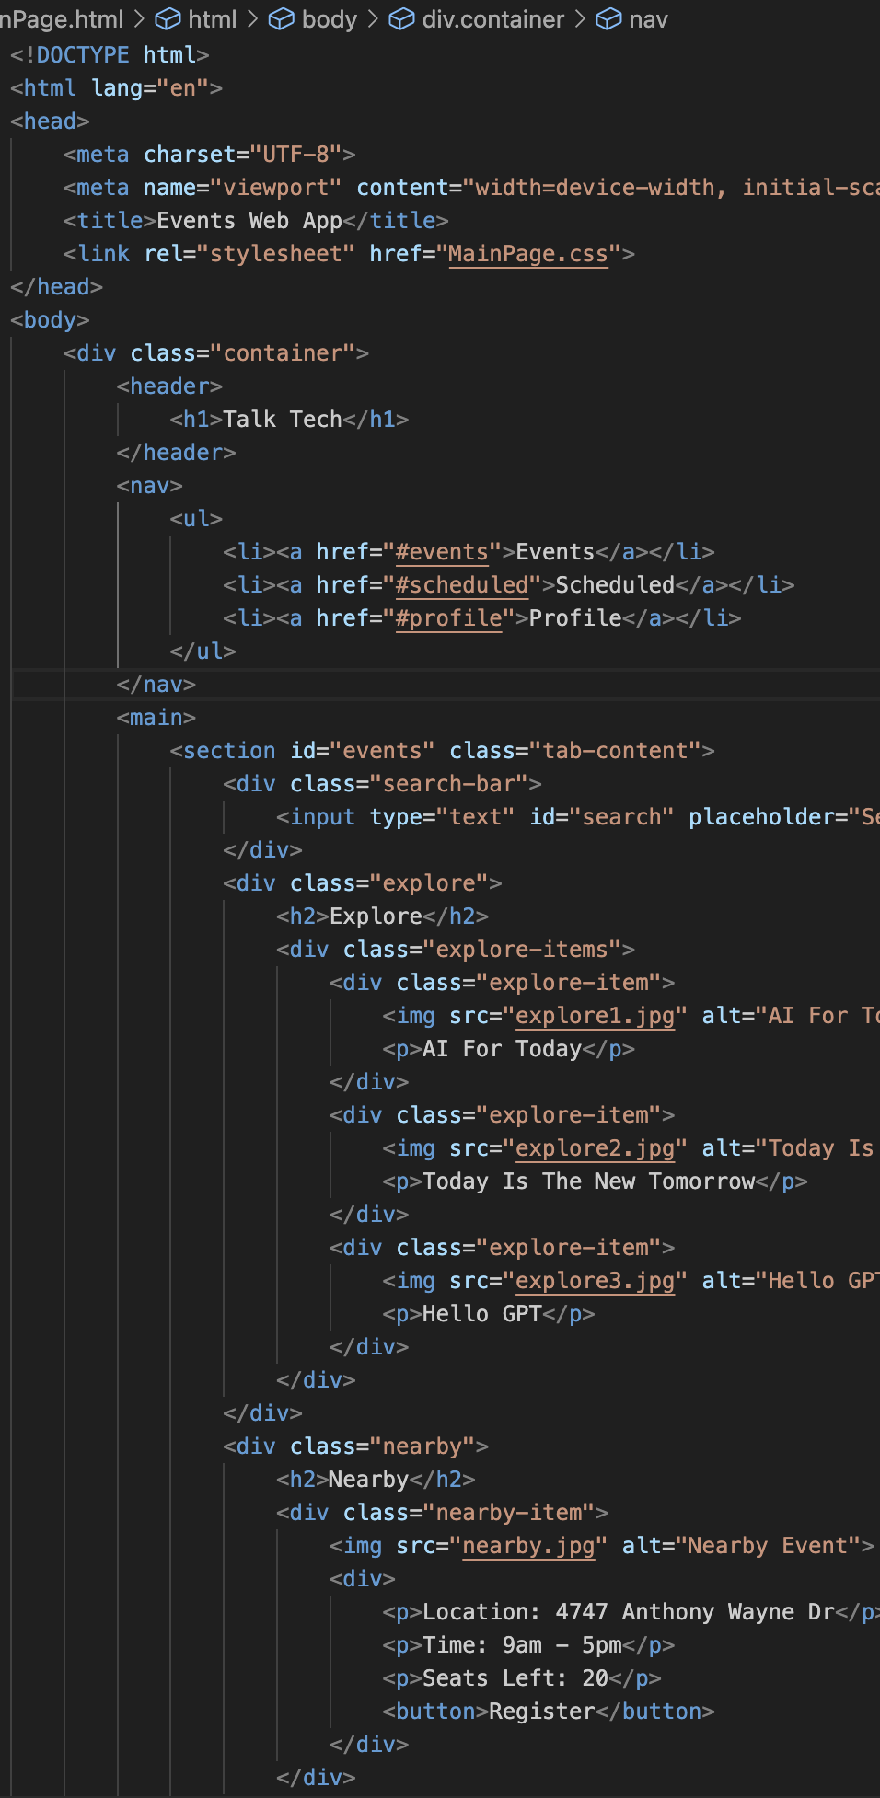
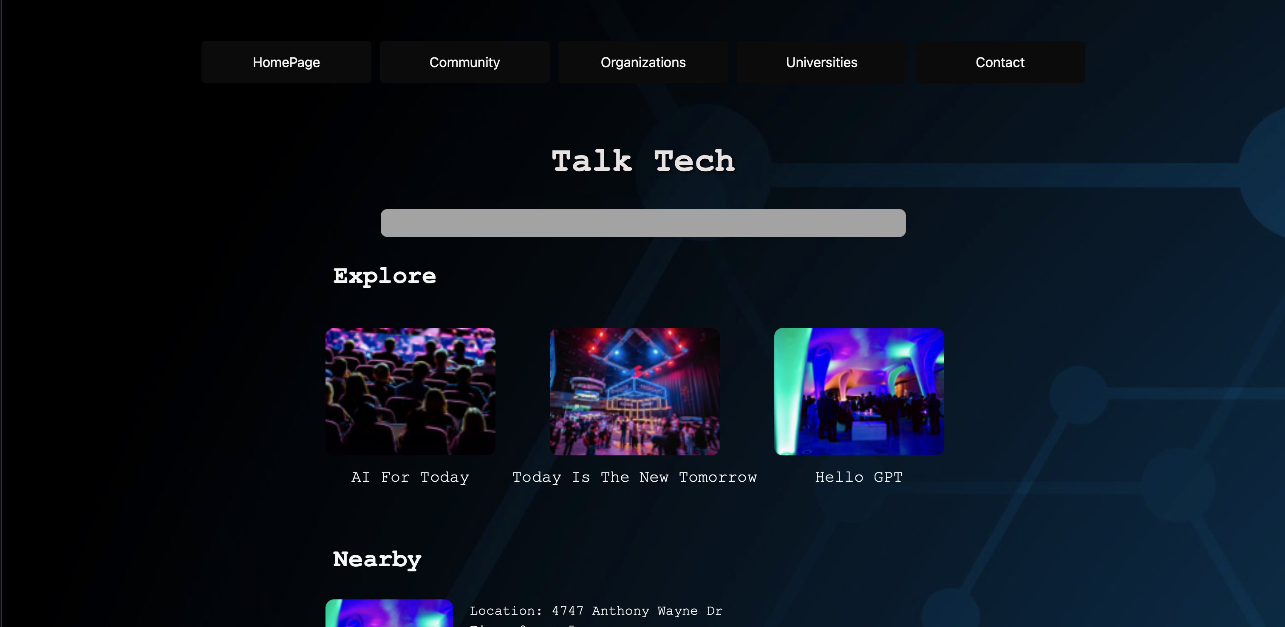
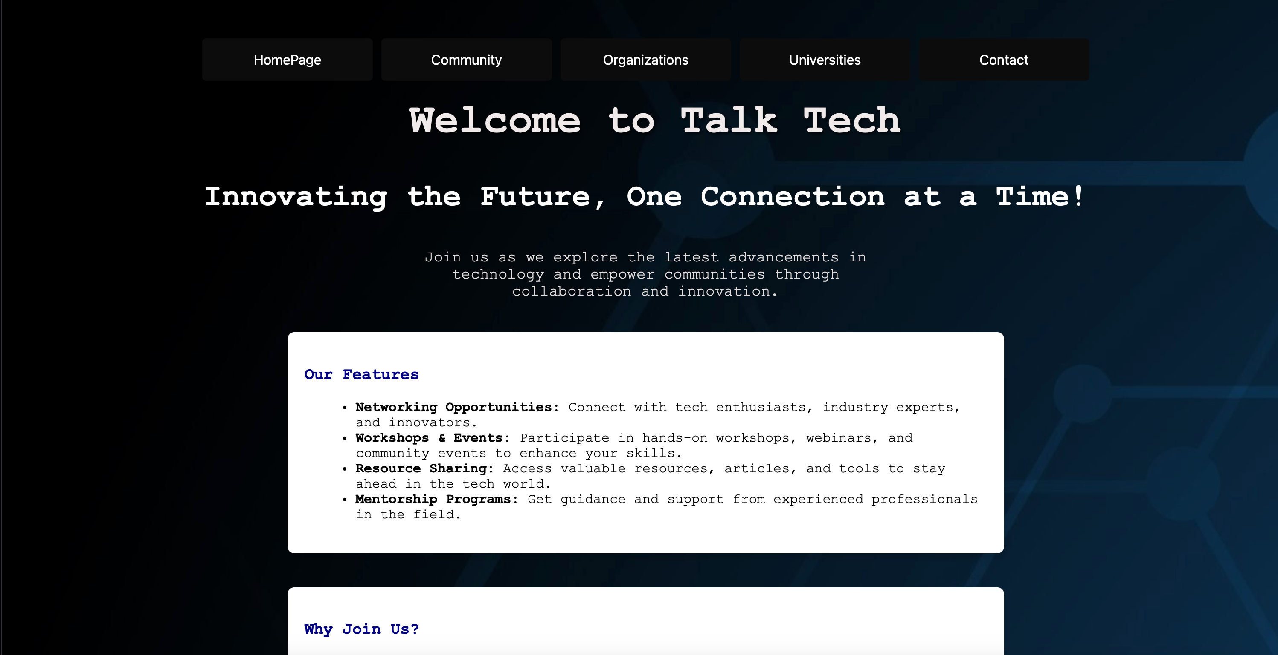
Website - The Backend

Slide 10
Thank you!

